Slide 1
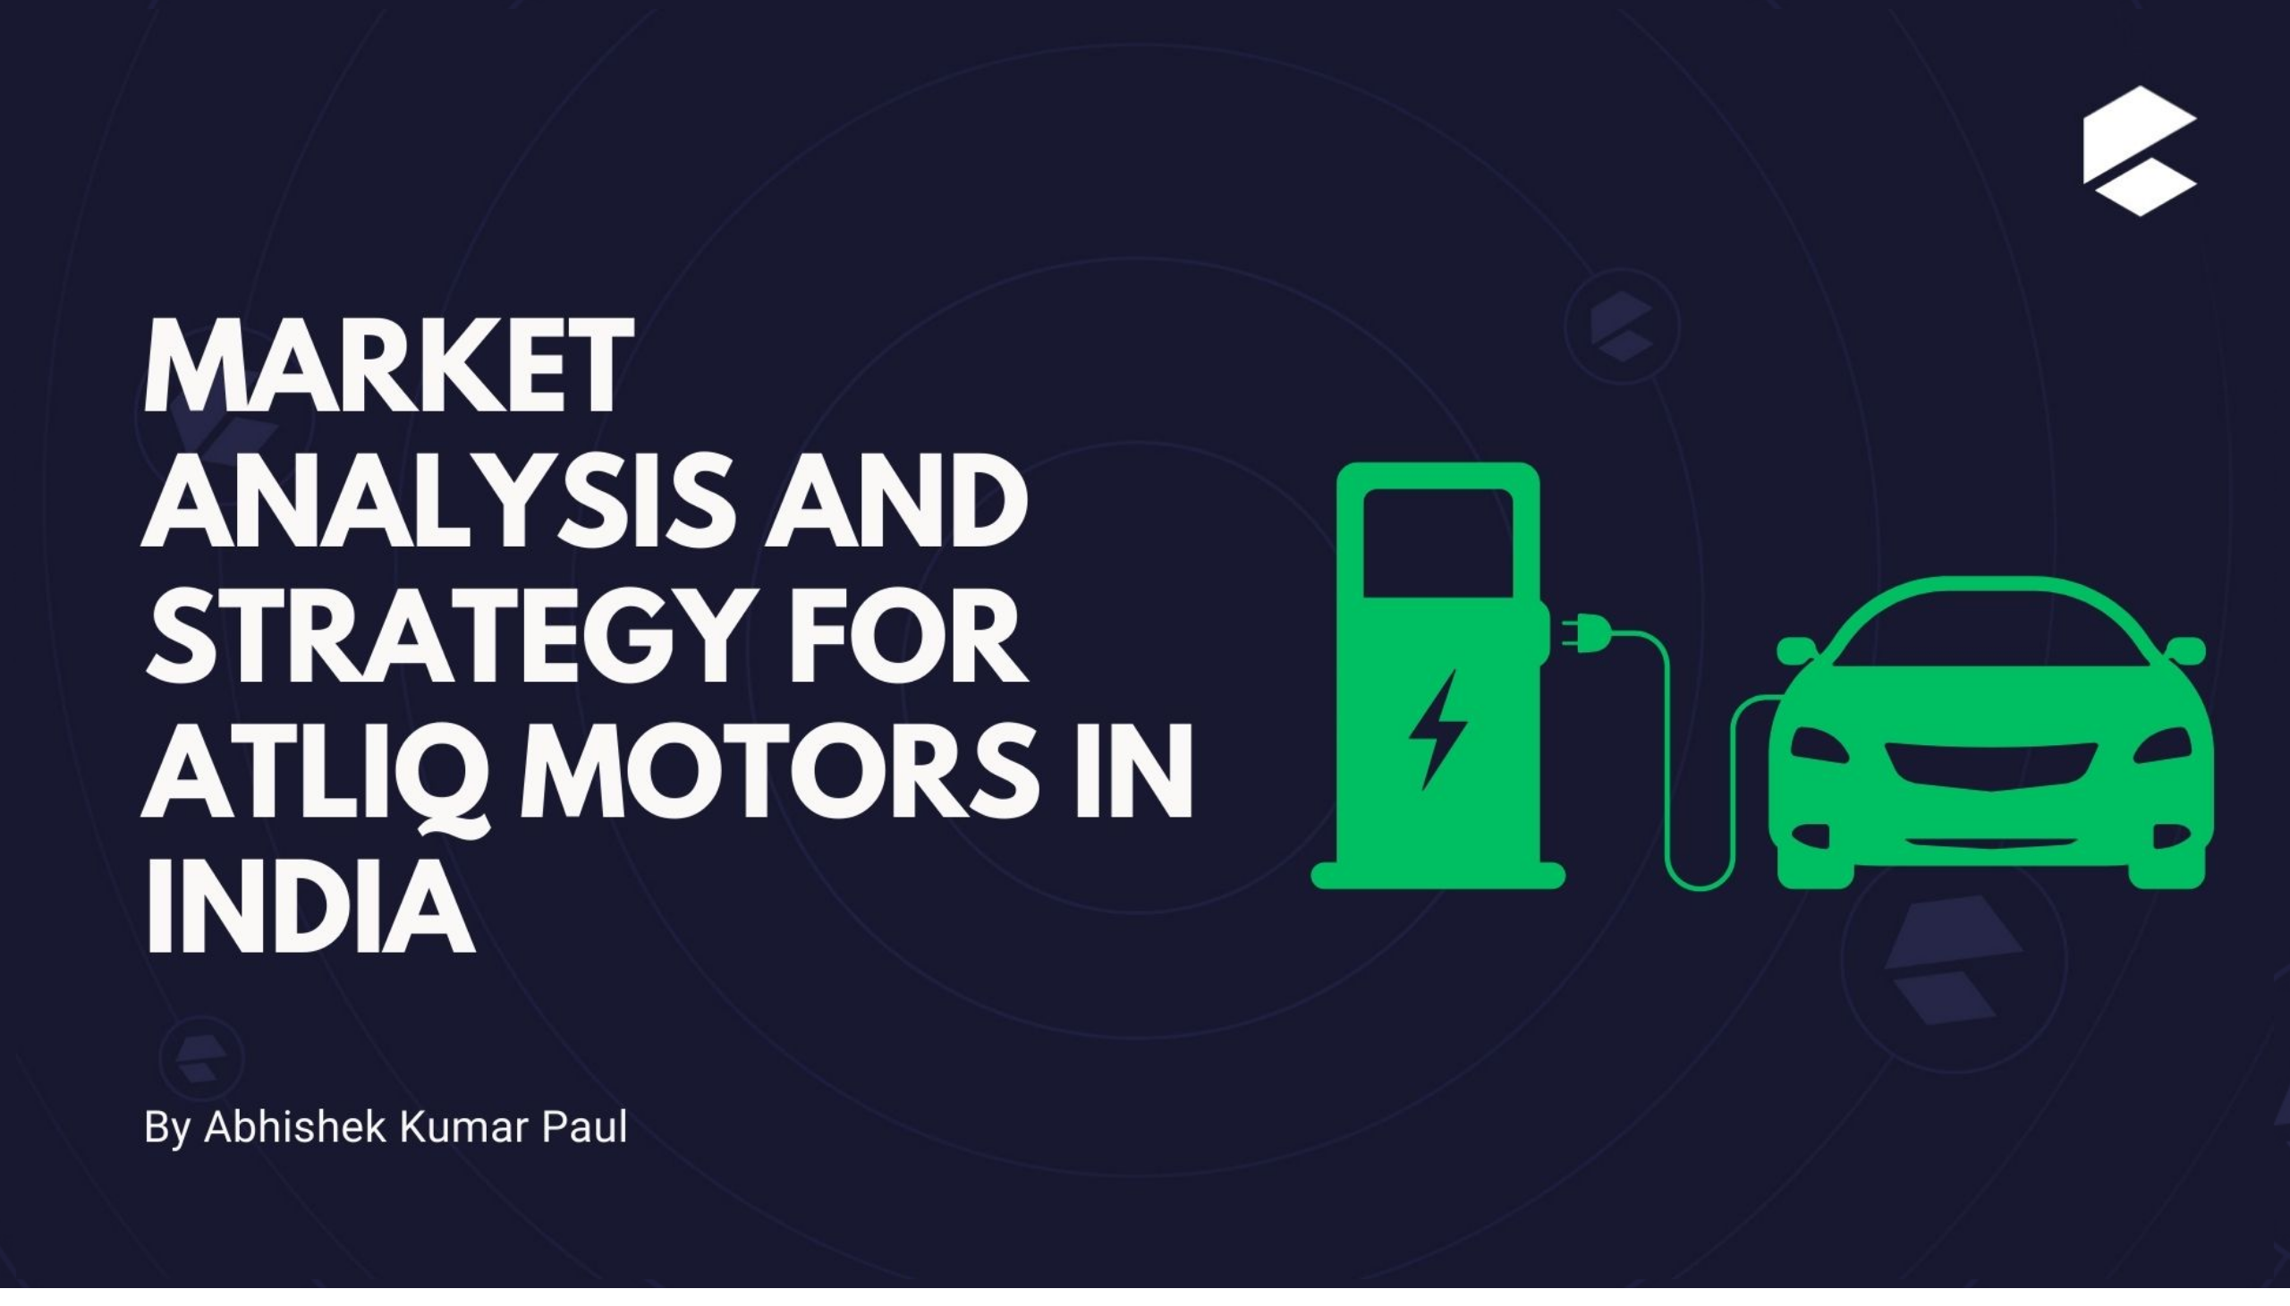
First Page
Notes:
image
No alt text provided

Slide 2
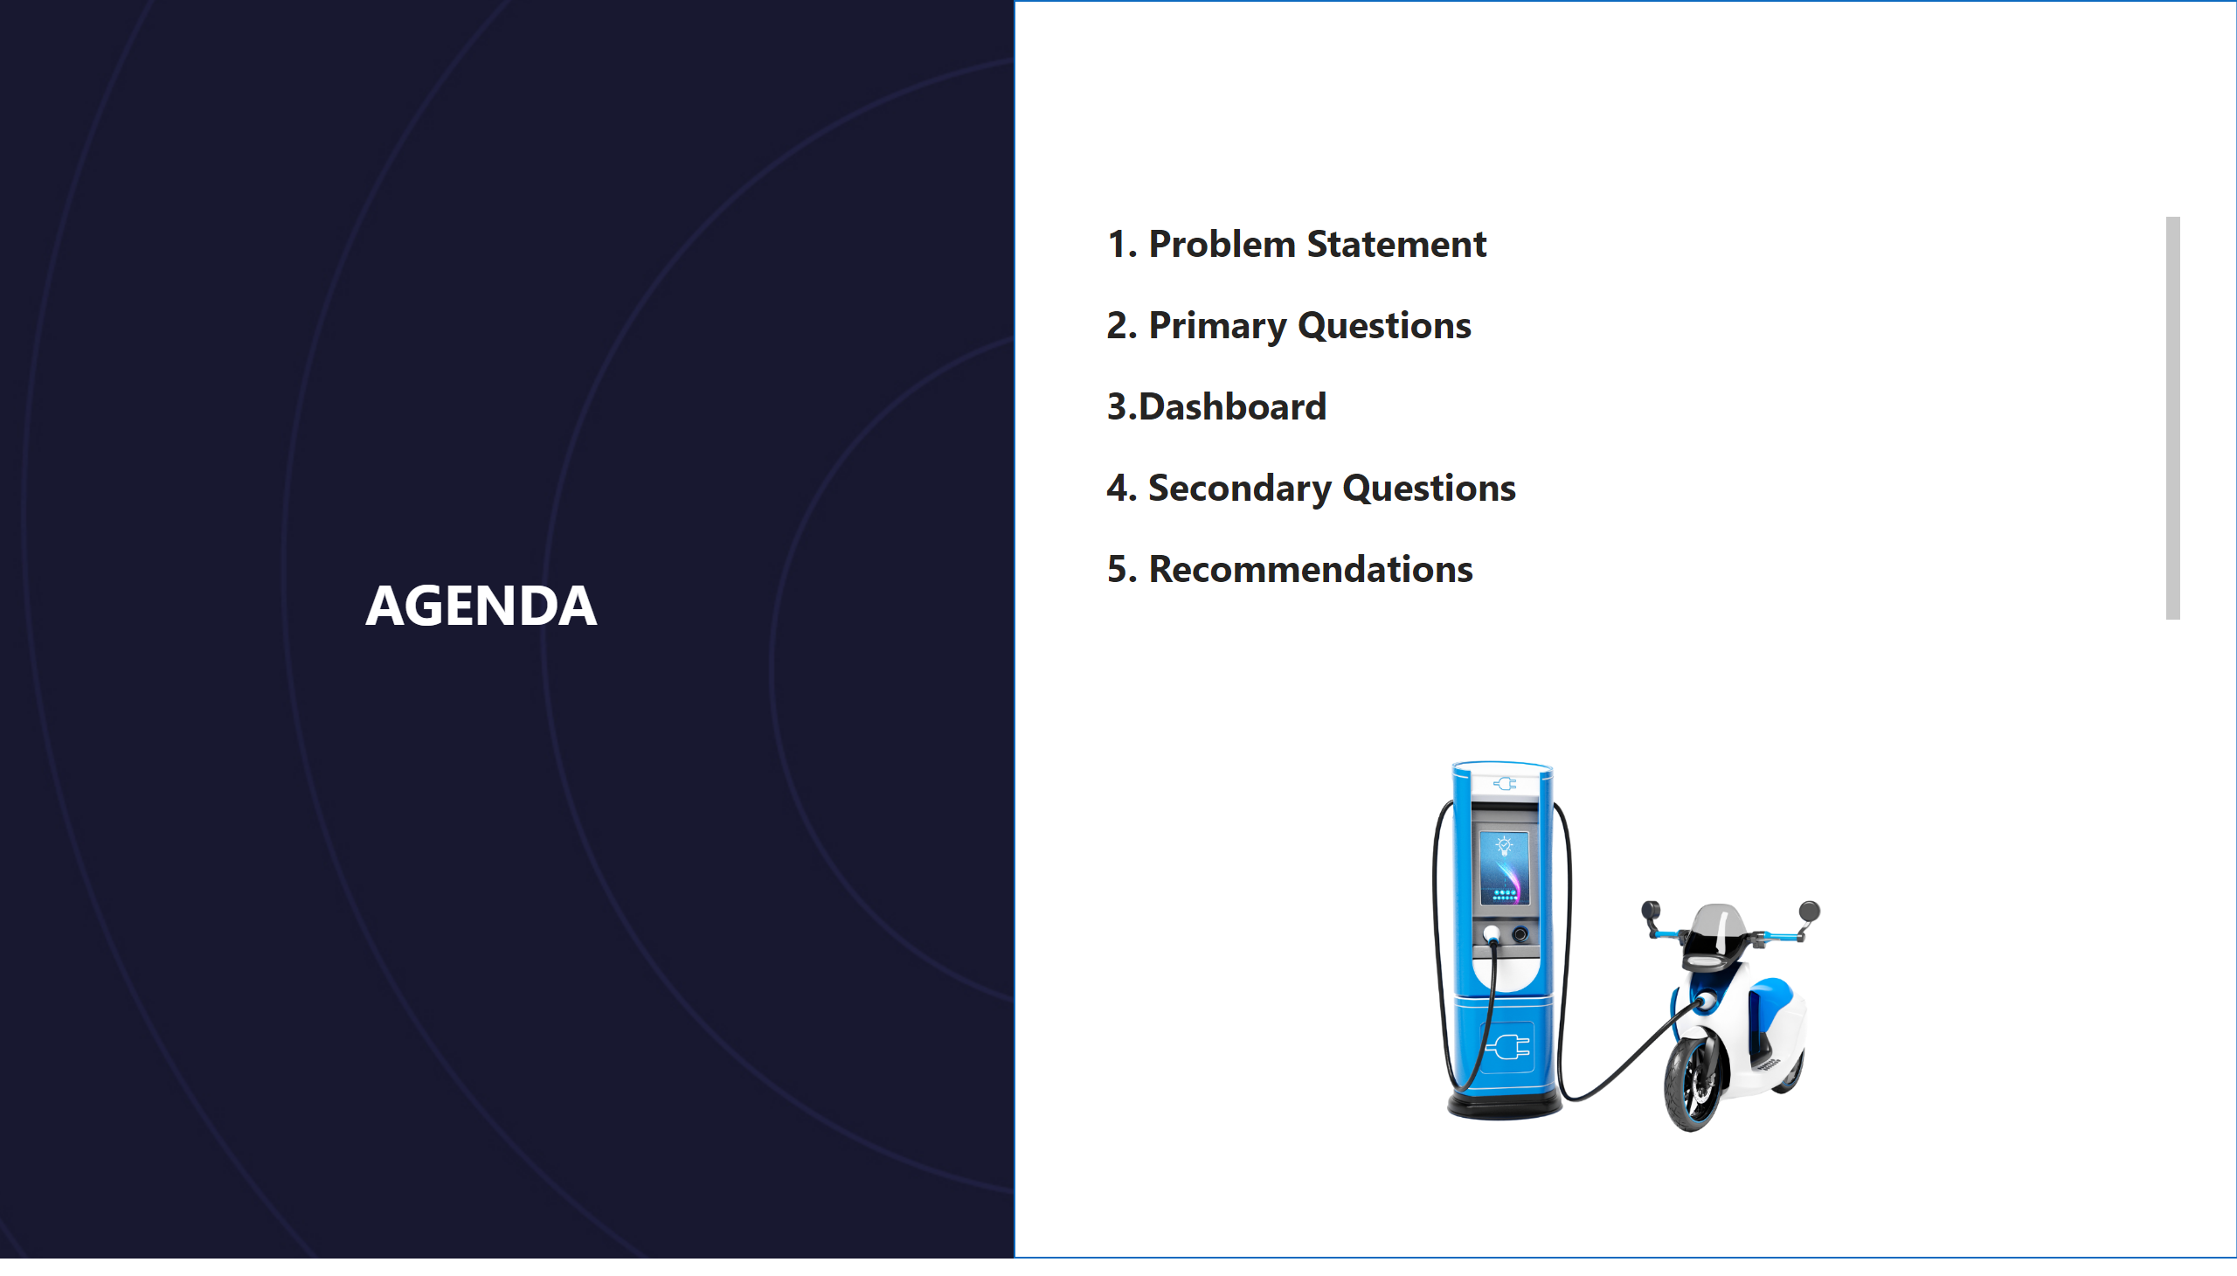
Agenda
Notes:
textbox
No alt text provided
textbox
No alt text provided
shape
No alt text provided
image
No alt text provided

Slide 3
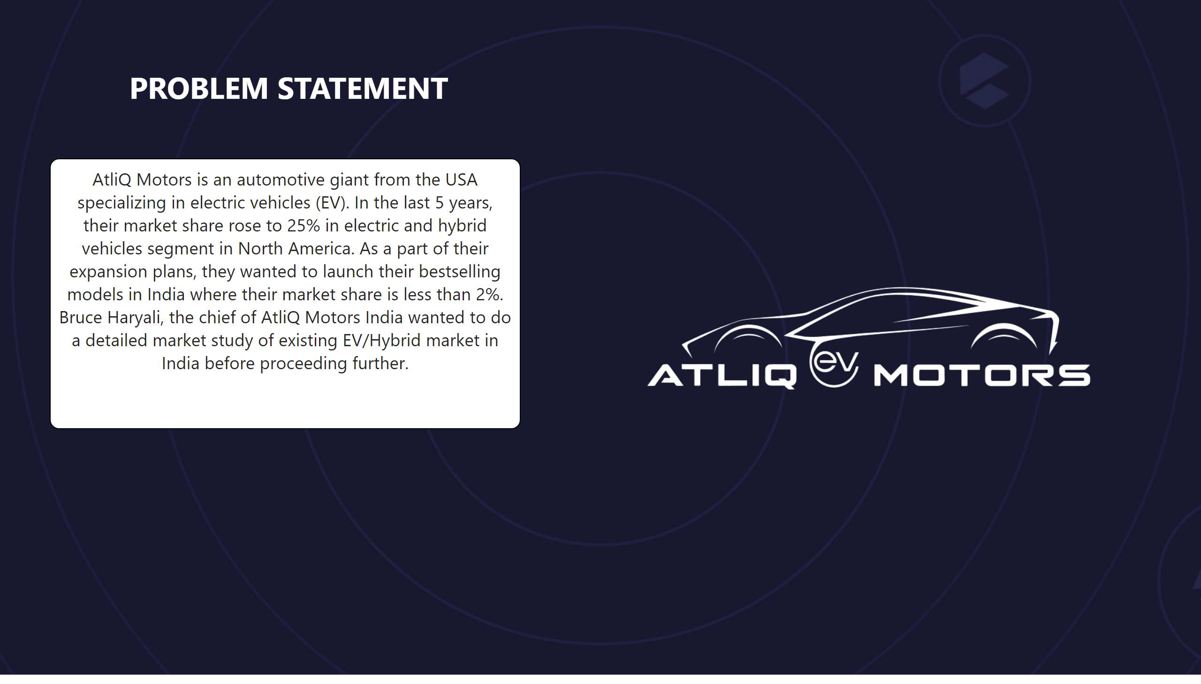
Problem
Notes:
textbox
No alt text provided
textbox
No alt text provided
image
No alt text provided

Slide 4
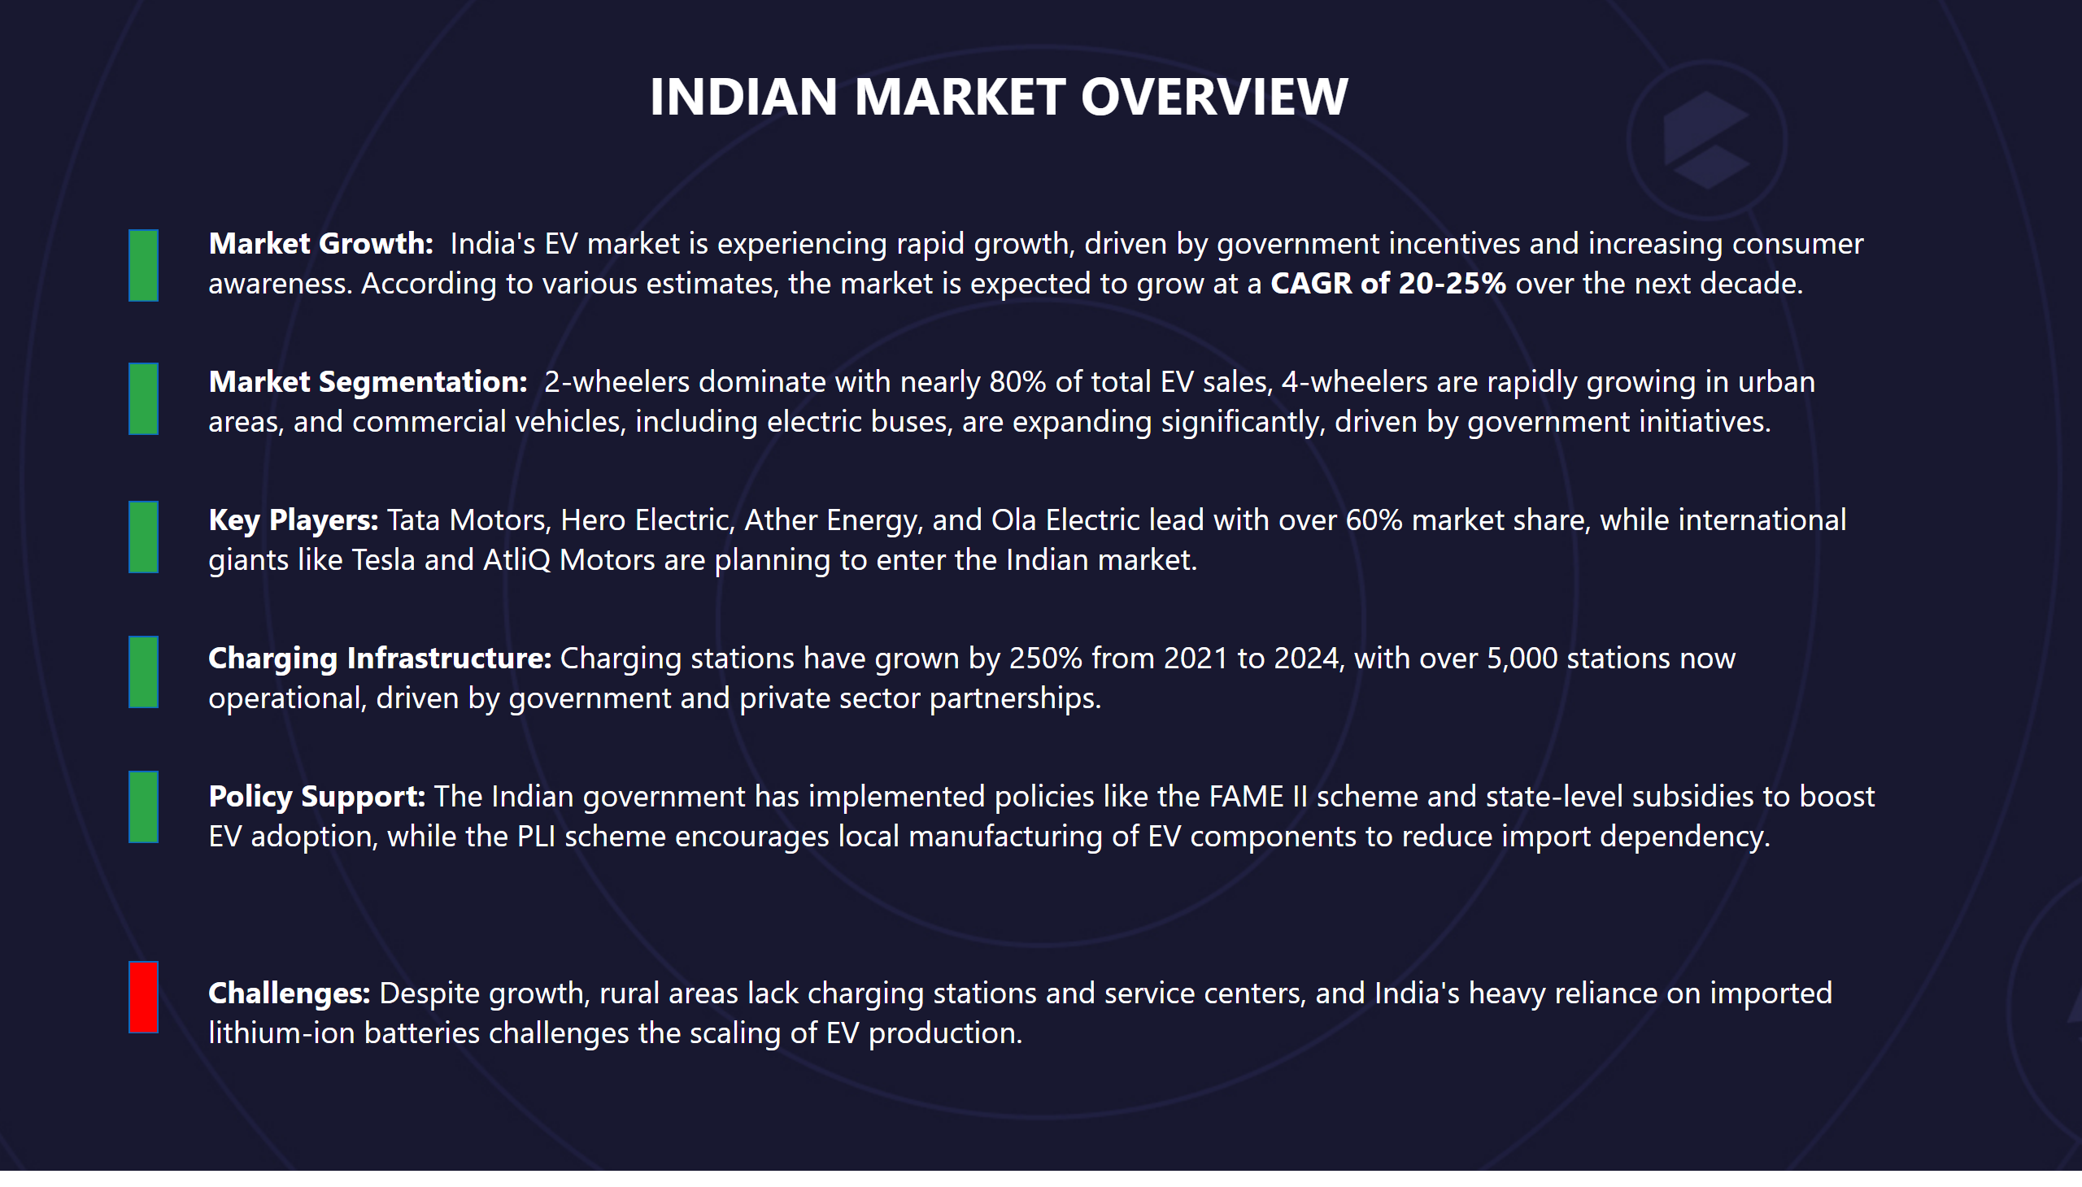
overview
Notes:
textbox
No alt text provided
textbox
No alt text provided
shape
No alt text provided
shape
No alt text provided
shape
No alt text provided
shape
No alt text provided
shape
No alt text provided
shape
No alt text provided

Slide 5
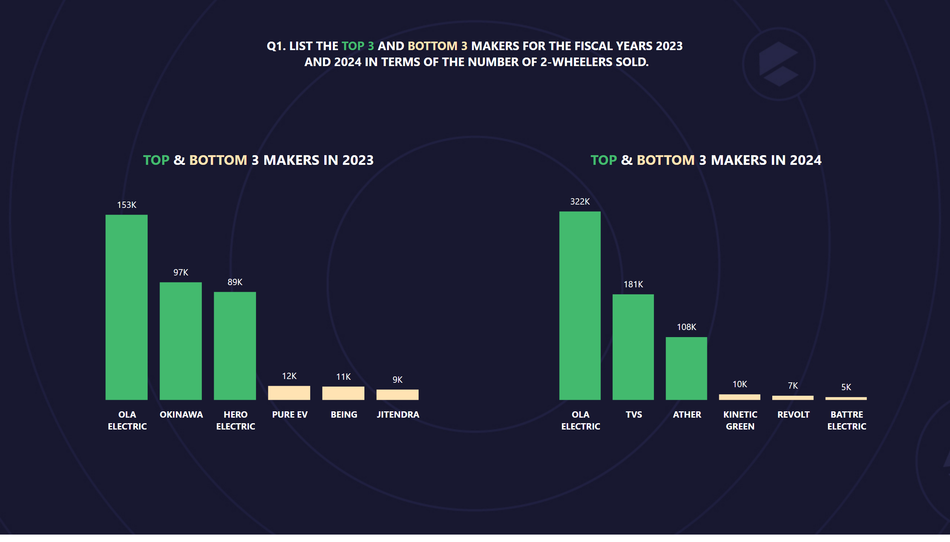
Q1
Notes:
clusteredColumnChart
No alt text provided
textbox
No alt text provided
clusteredColumnChart
No alt text provided
textbox
No alt text provided
textbox
No alt text provided

Slide 6
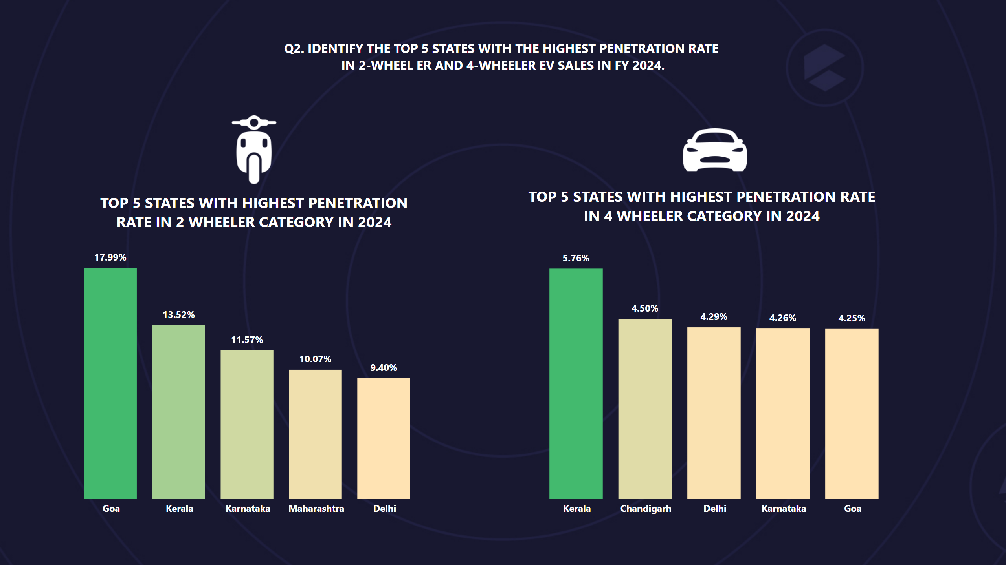
Q2
Notes:
textbox
No alt text provided
textbox
No alt text provided
textbox
No alt text provided
clusteredColumnChart
No alt text provided
clusteredColumnChart
No alt text provided
image
No alt text provided
image
No alt text provided

Slide 7
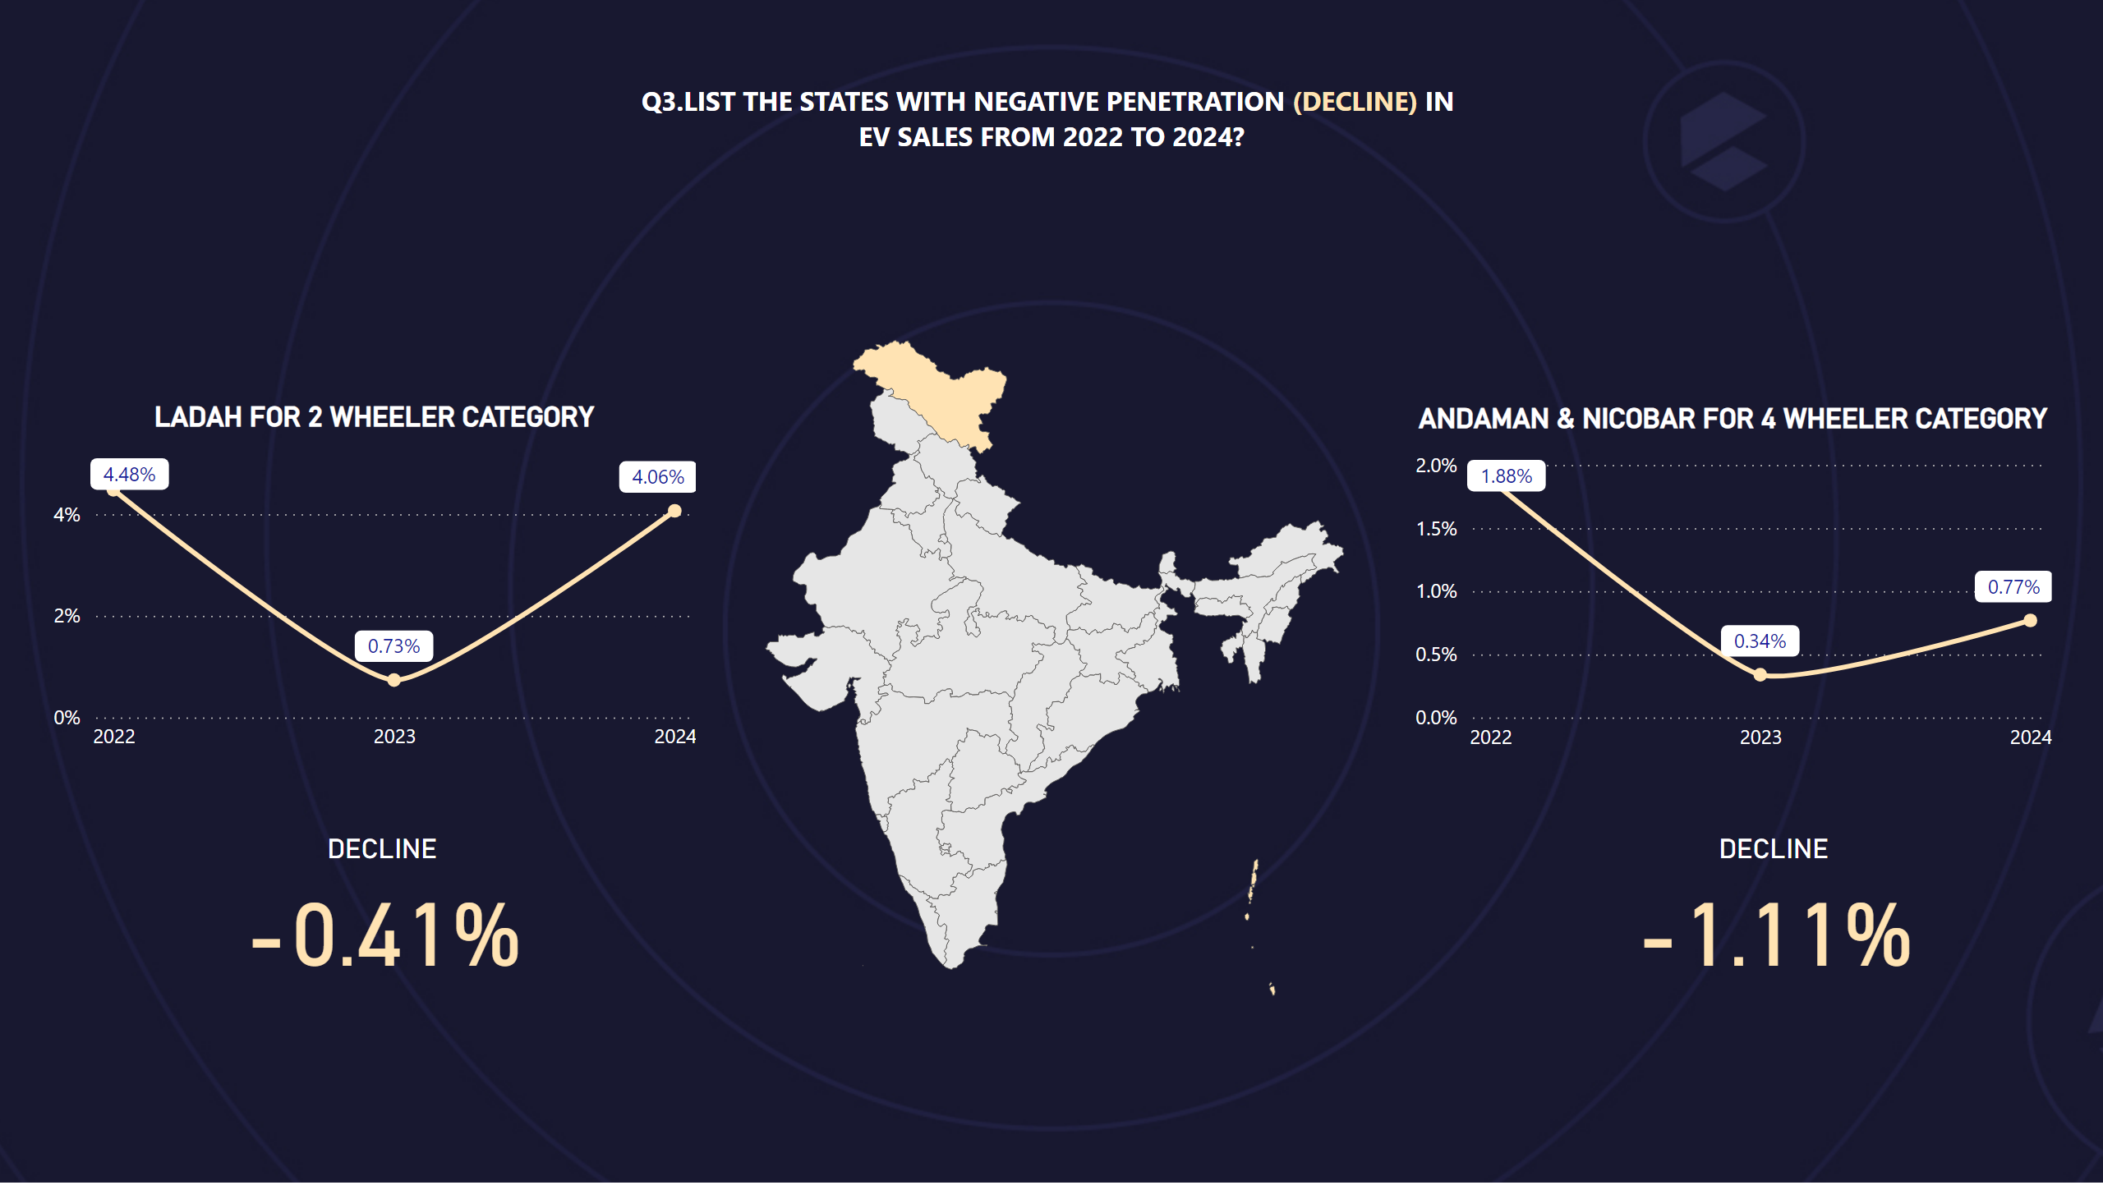
Q3
Notes:
CAGR by state
No alt text provided
LADAH FOR 2 WHEELER CATEGORY
No alt text provided
ANDAMAN & NICOBAR FOR 4 WHEELER CATEGORY
No alt text provided
DECLINE
No alt text provided
DECLINE
No alt text provided
textbox
No alt text provided

Slide 8
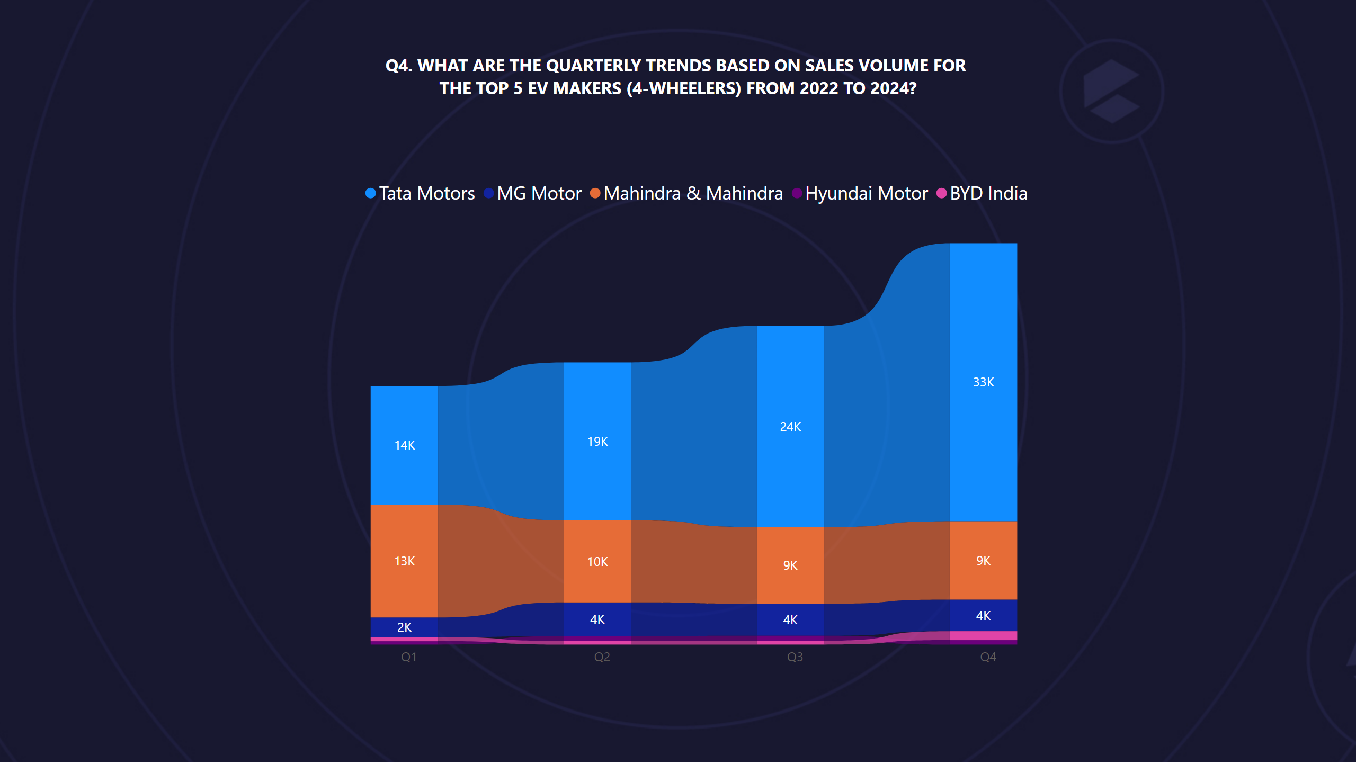
Q4
Notes:
ribbonChart
No alt text provided
textbox
No alt text provided

Slide 9
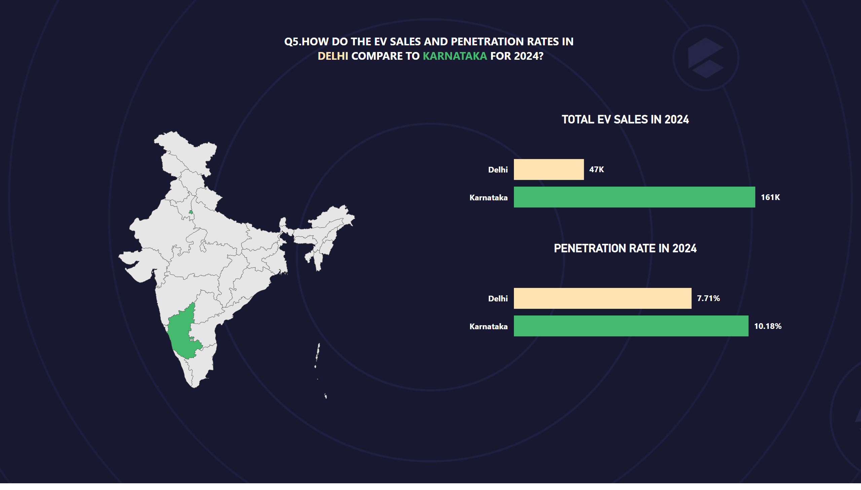
Q5
Notes:
textbox
No alt text provided
CAGR by state
No alt text provided
TOTAL EV SALES IN 2024
No alt text provided
PENETRATION RATE IN 2024
No alt text provided

Slide 10
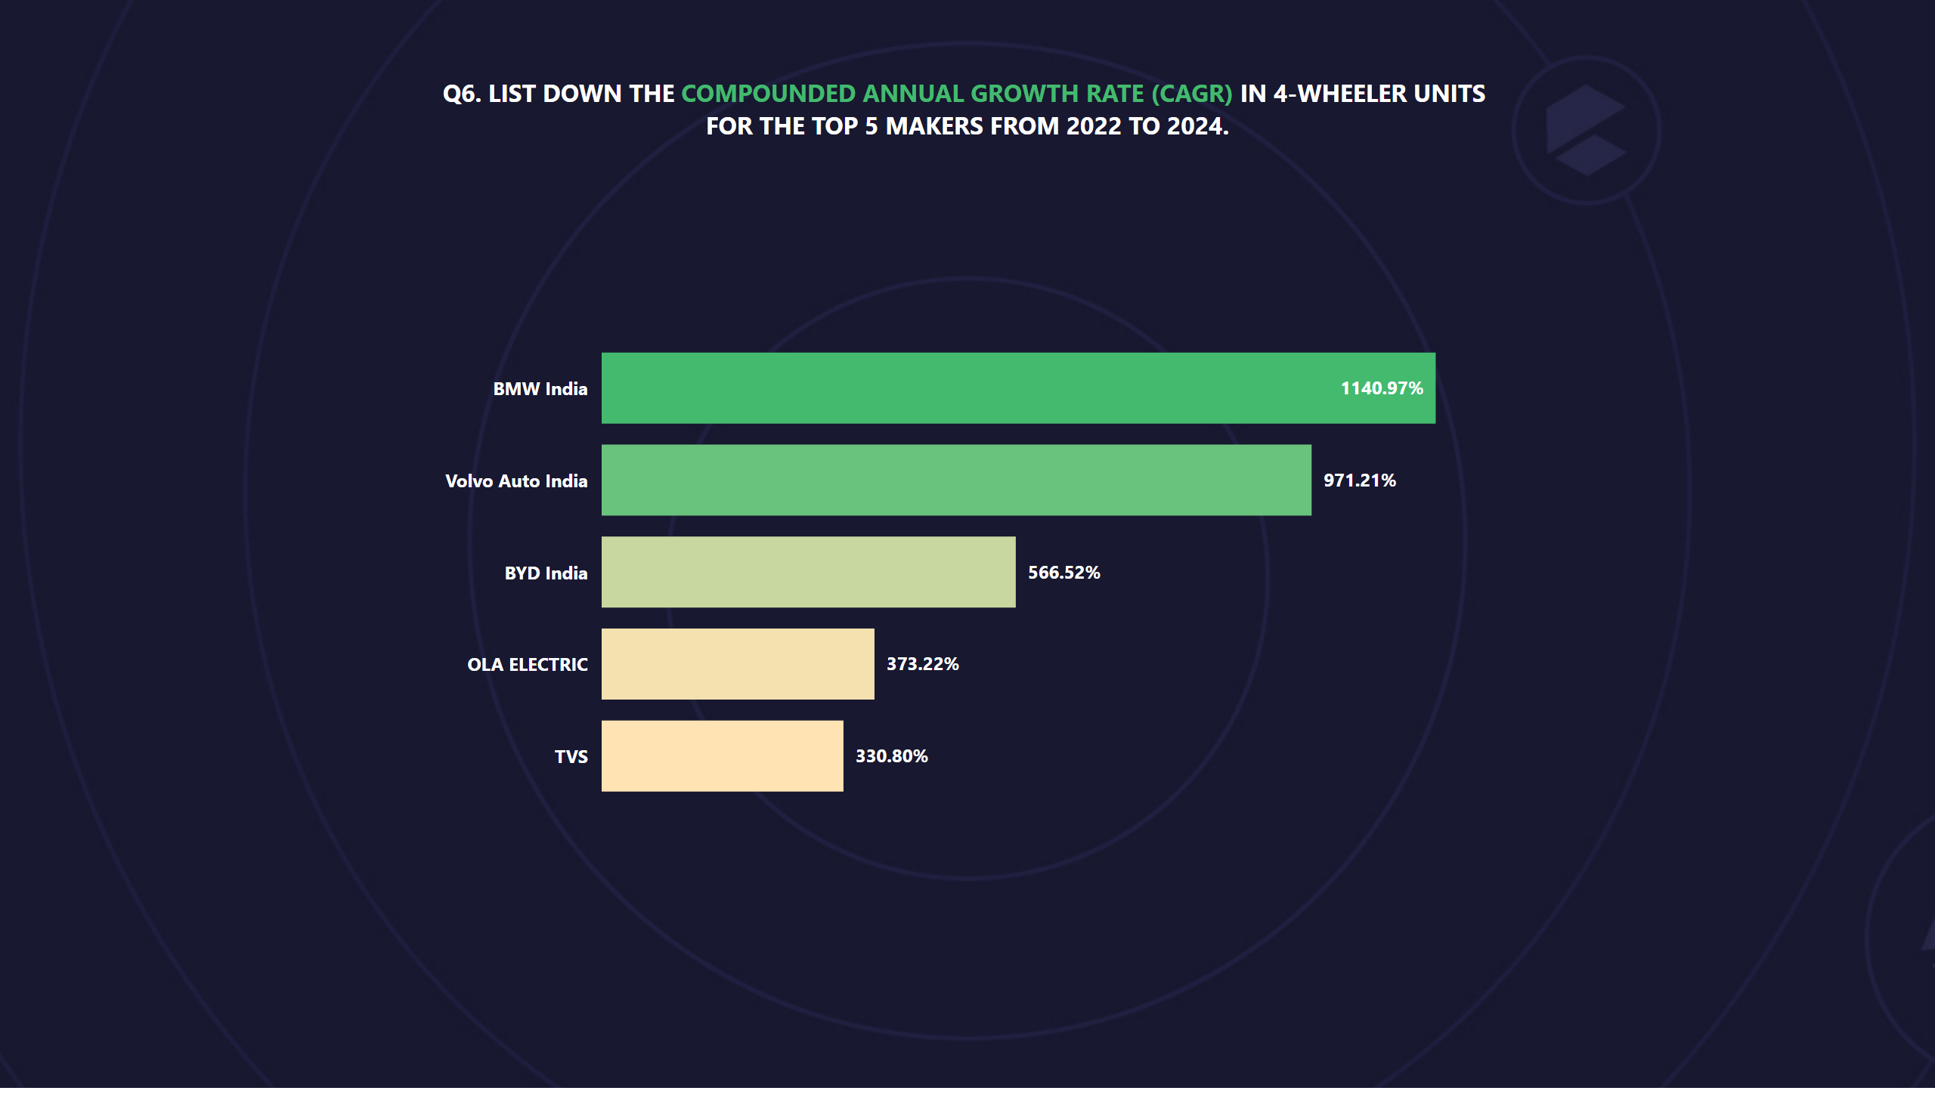
Q6
Notes:
textbox
No alt text provided
clusteredBarChart
No alt text provided

Slide 11
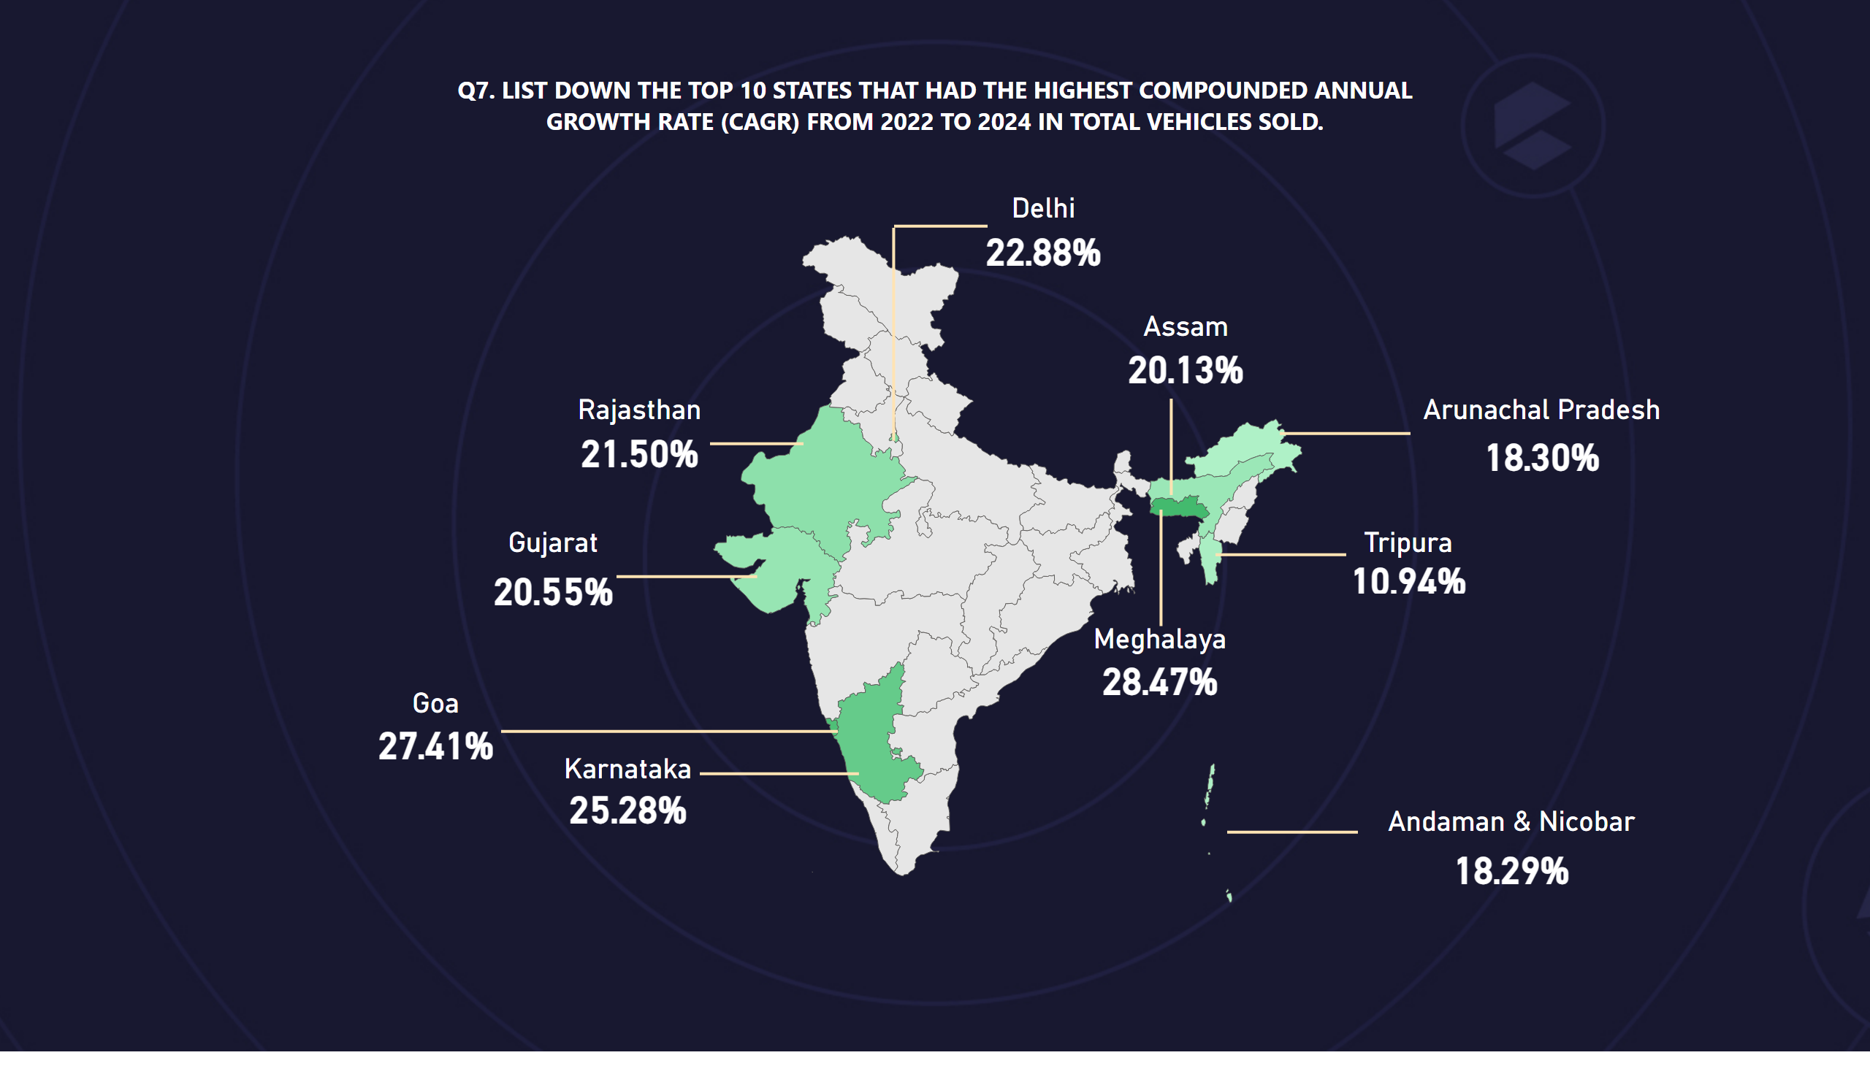
Q7
Notes:
textbox
No alt text provided
CAGR by state
No alt text provided
Karnataka
No alt text provided
Goa
No alt text provided
Gujarat
No alt text provided
Rajasthan
No alt text provided
Delhi
No alt text provided
Arunachal Pradesh
No alt text provided
Assam
No alt text provided
Tripura
No alt text provided
Meghalaya
No alt text provided
Andaman & Nicobar
No alt text provided
shape
No alt text provided
shape
No alt text provided
shape
No alt text provided
shape
No alt text provided
shape
No alt text provided
shape
No alt text provided
shape
No alt text provided
shape
No alt text provided
shape
No alt text provided
shape
No alt text provided
shape
No alt text provided

Slide 12
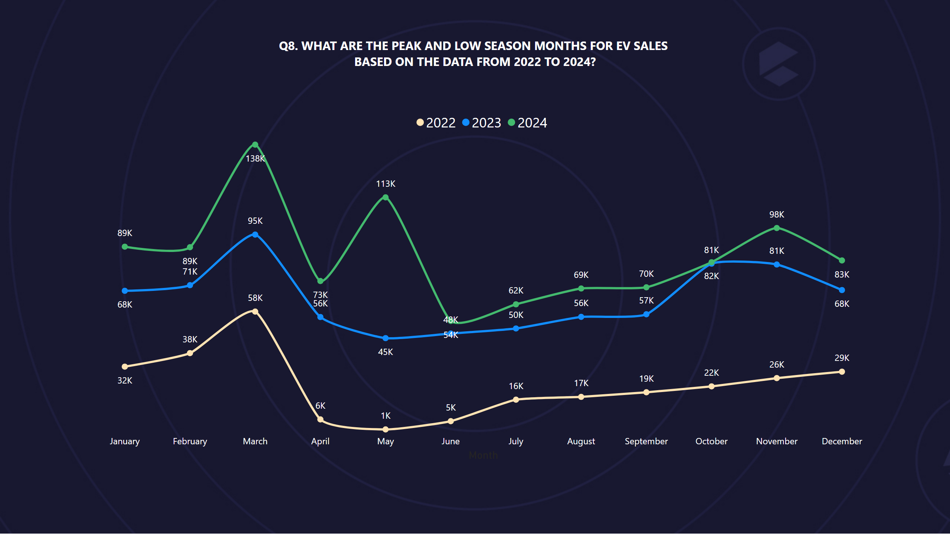
Q8
Notes:
textbox
No alt text provided
lineChart
No alt text provided

Slide 13
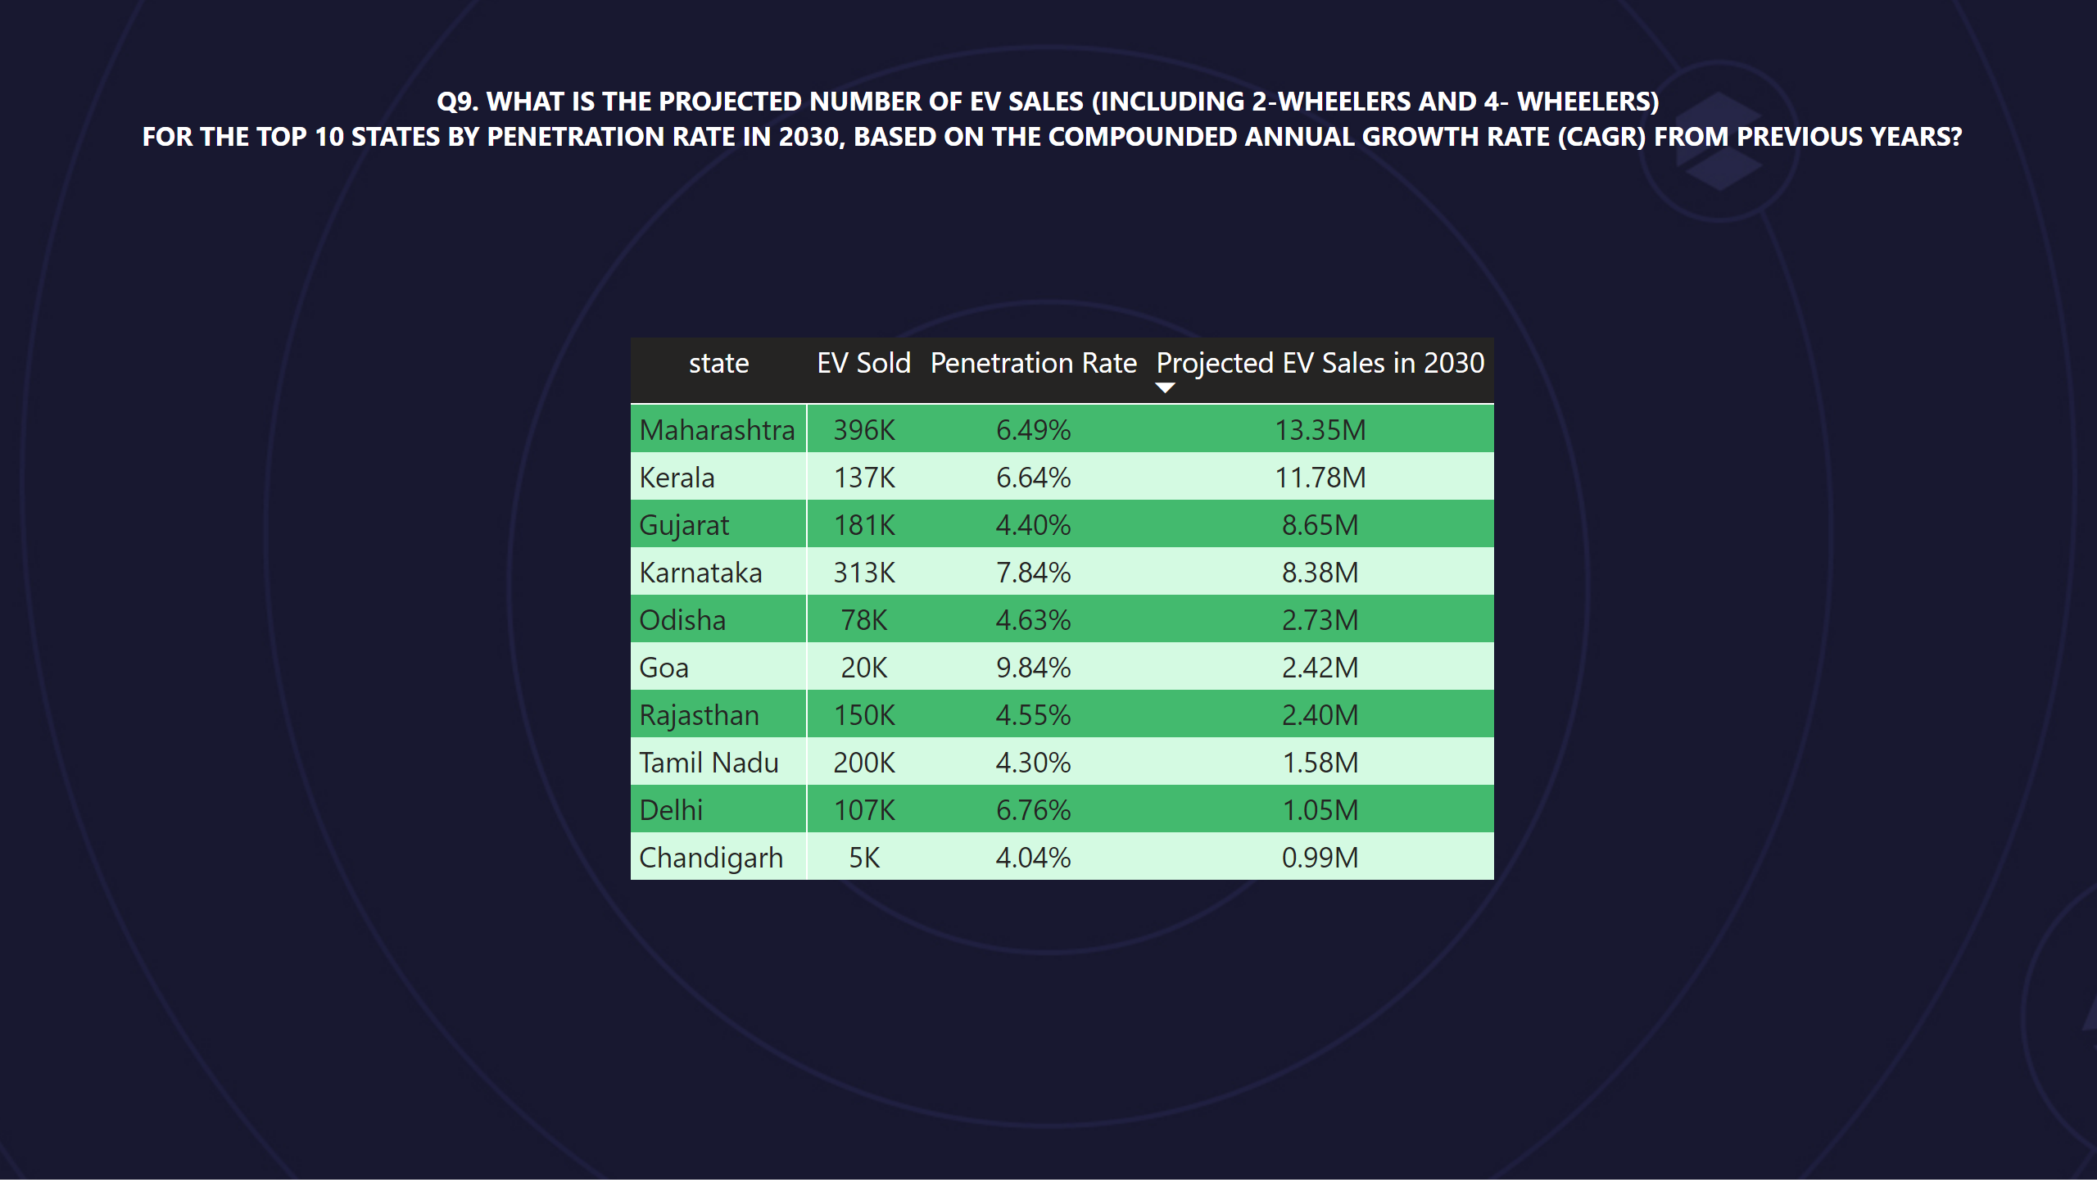
Q9
Notes:
textbox
No alt text provided
pivotTable
No alt text provided

Slide 14
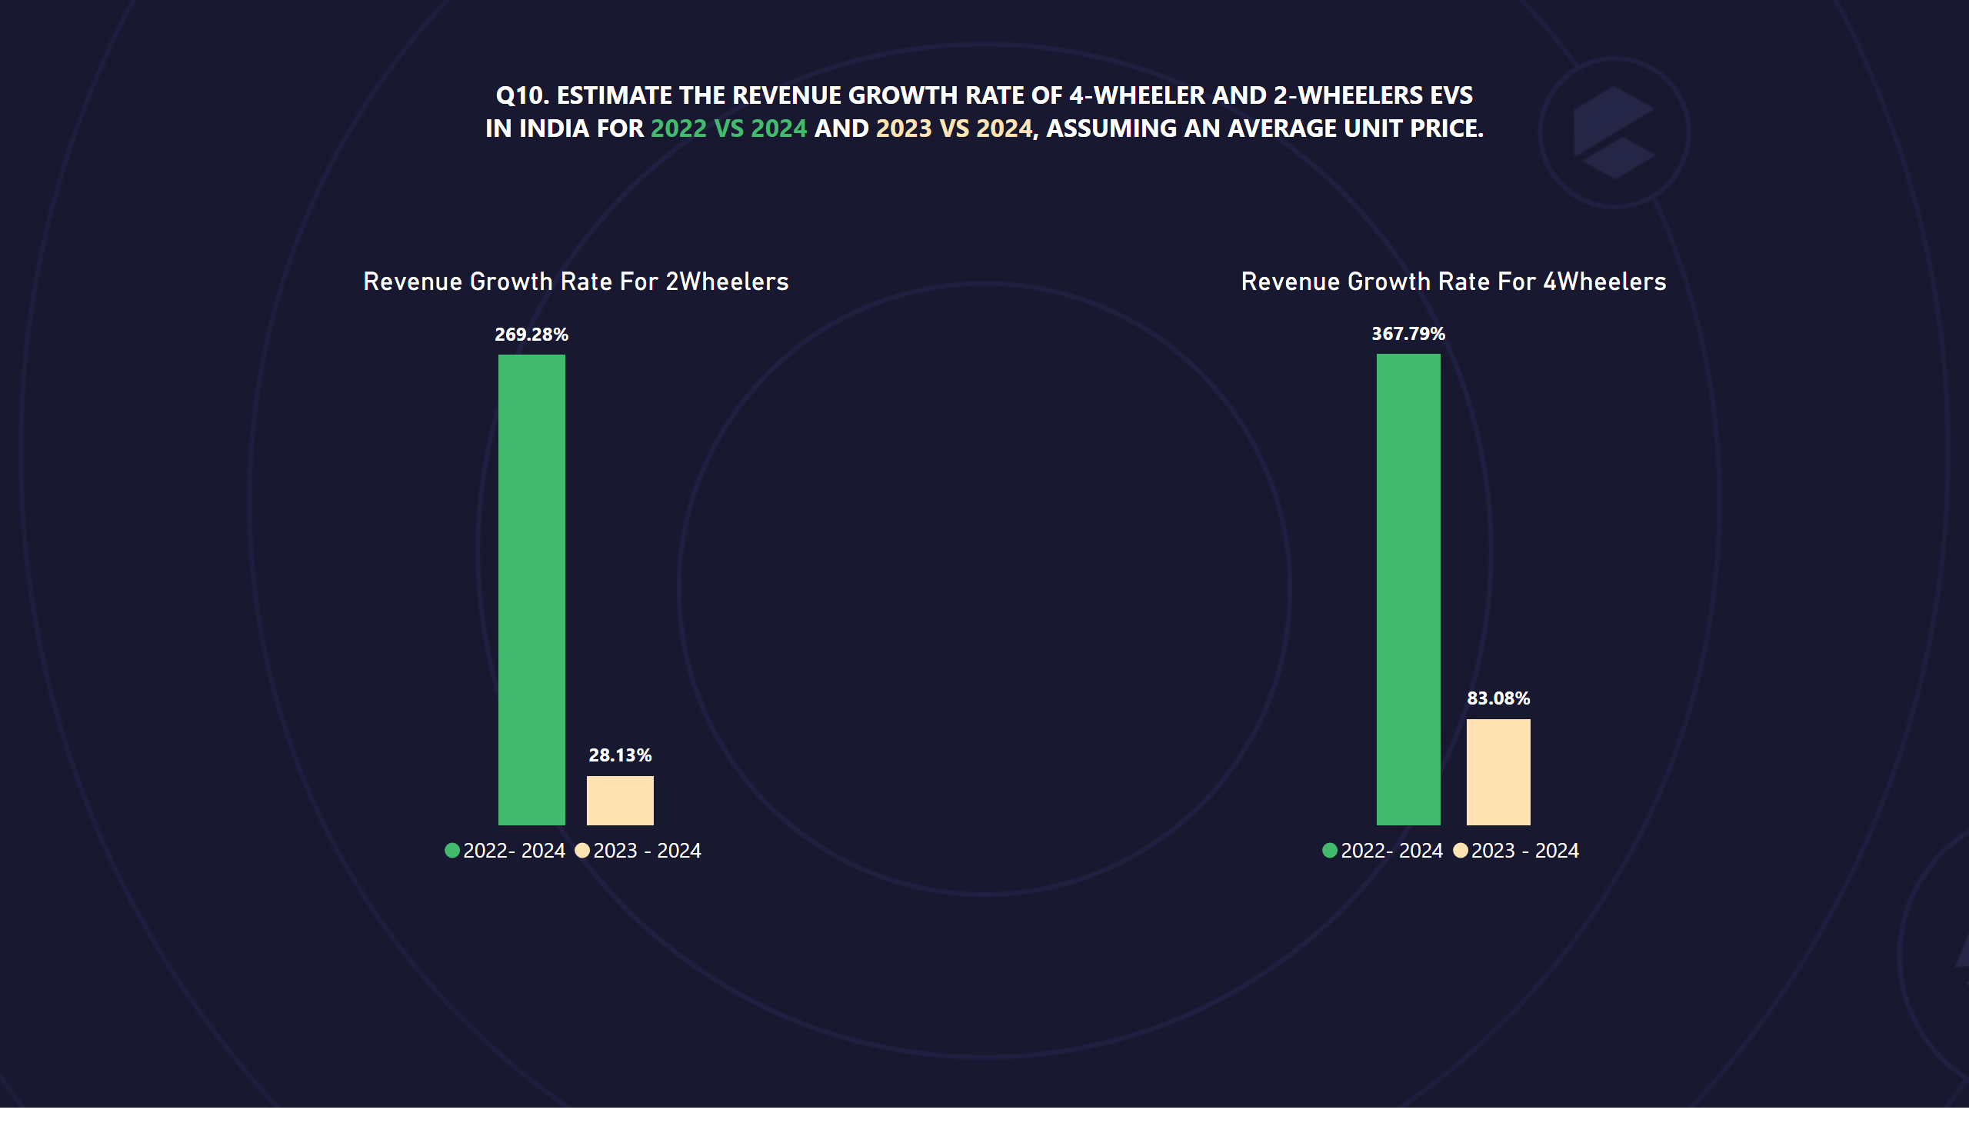
Q10
Notes:
textbox
No alt text provided
Revenue Growth Rate For 2Wheelers
No alt text provided
Revenue Growth Rate For 4Wheelers
No alt text provided

Slide 15
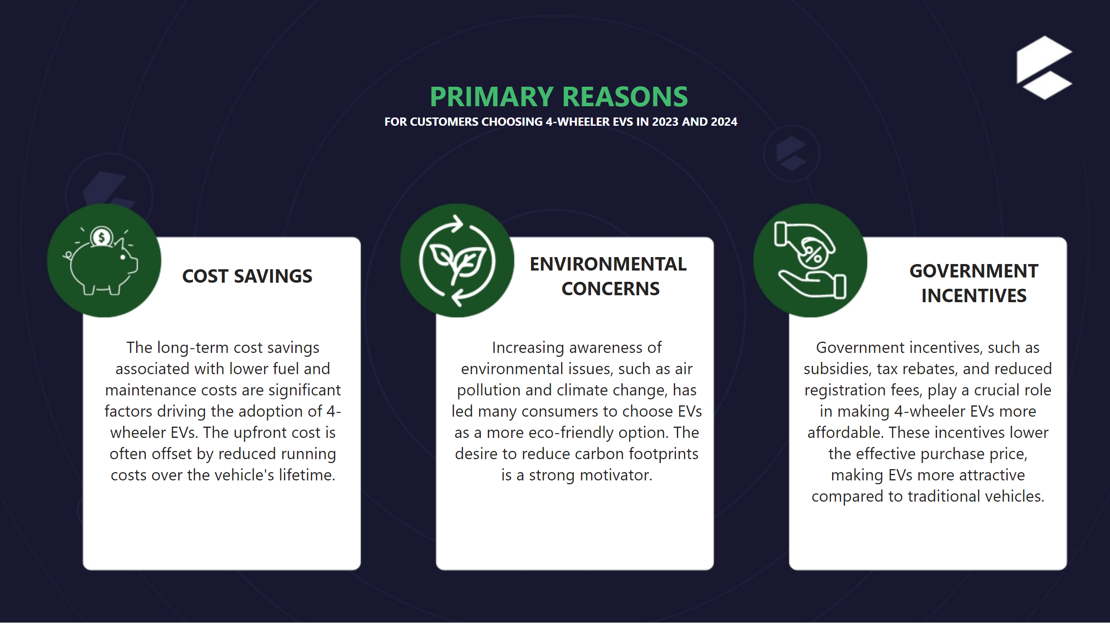
Primary Drivers
Notes:
textbox
No alt text provided
textbox
No alt text provided
textbox
No alt text provided
textbox
No alt text provided
textbox
No alt text provided
textbox
No alt text provided
textbox
No alt text provided

Slide 16
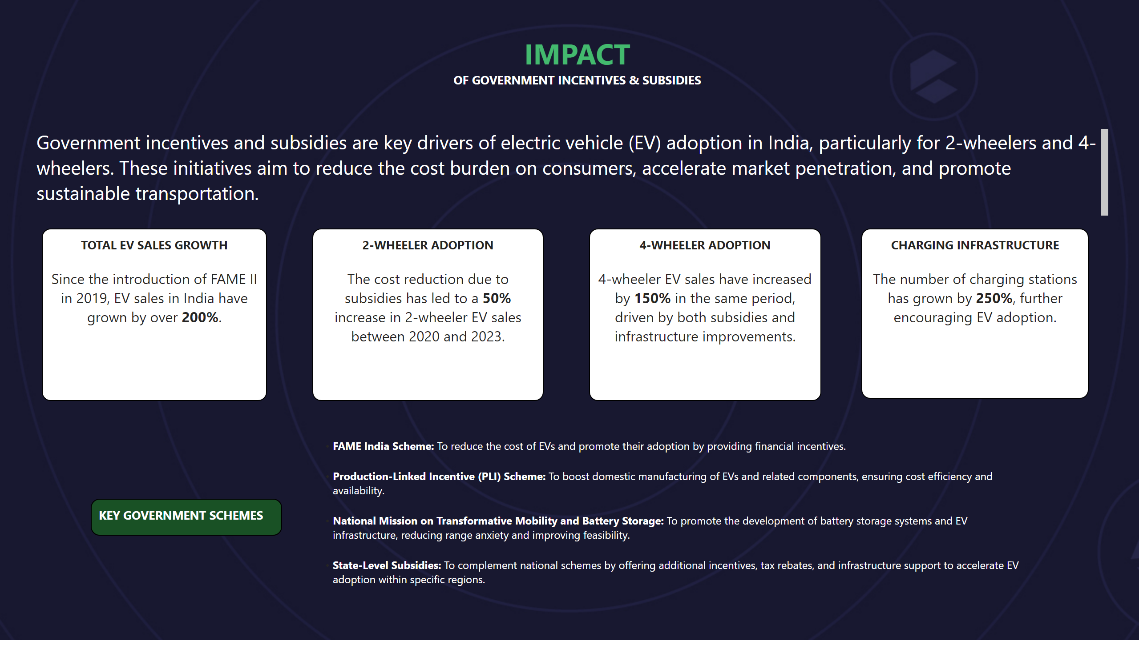
Impact
Notes:
textbox
No alt text provided
textbox
No alt text provided
textbox
No alt text provided
textbox
No alt text provided
textbox
No alt text provided
textbox
No alt text provided
textbox
No alt text provided
textbox
No alt text provided

Slide 17
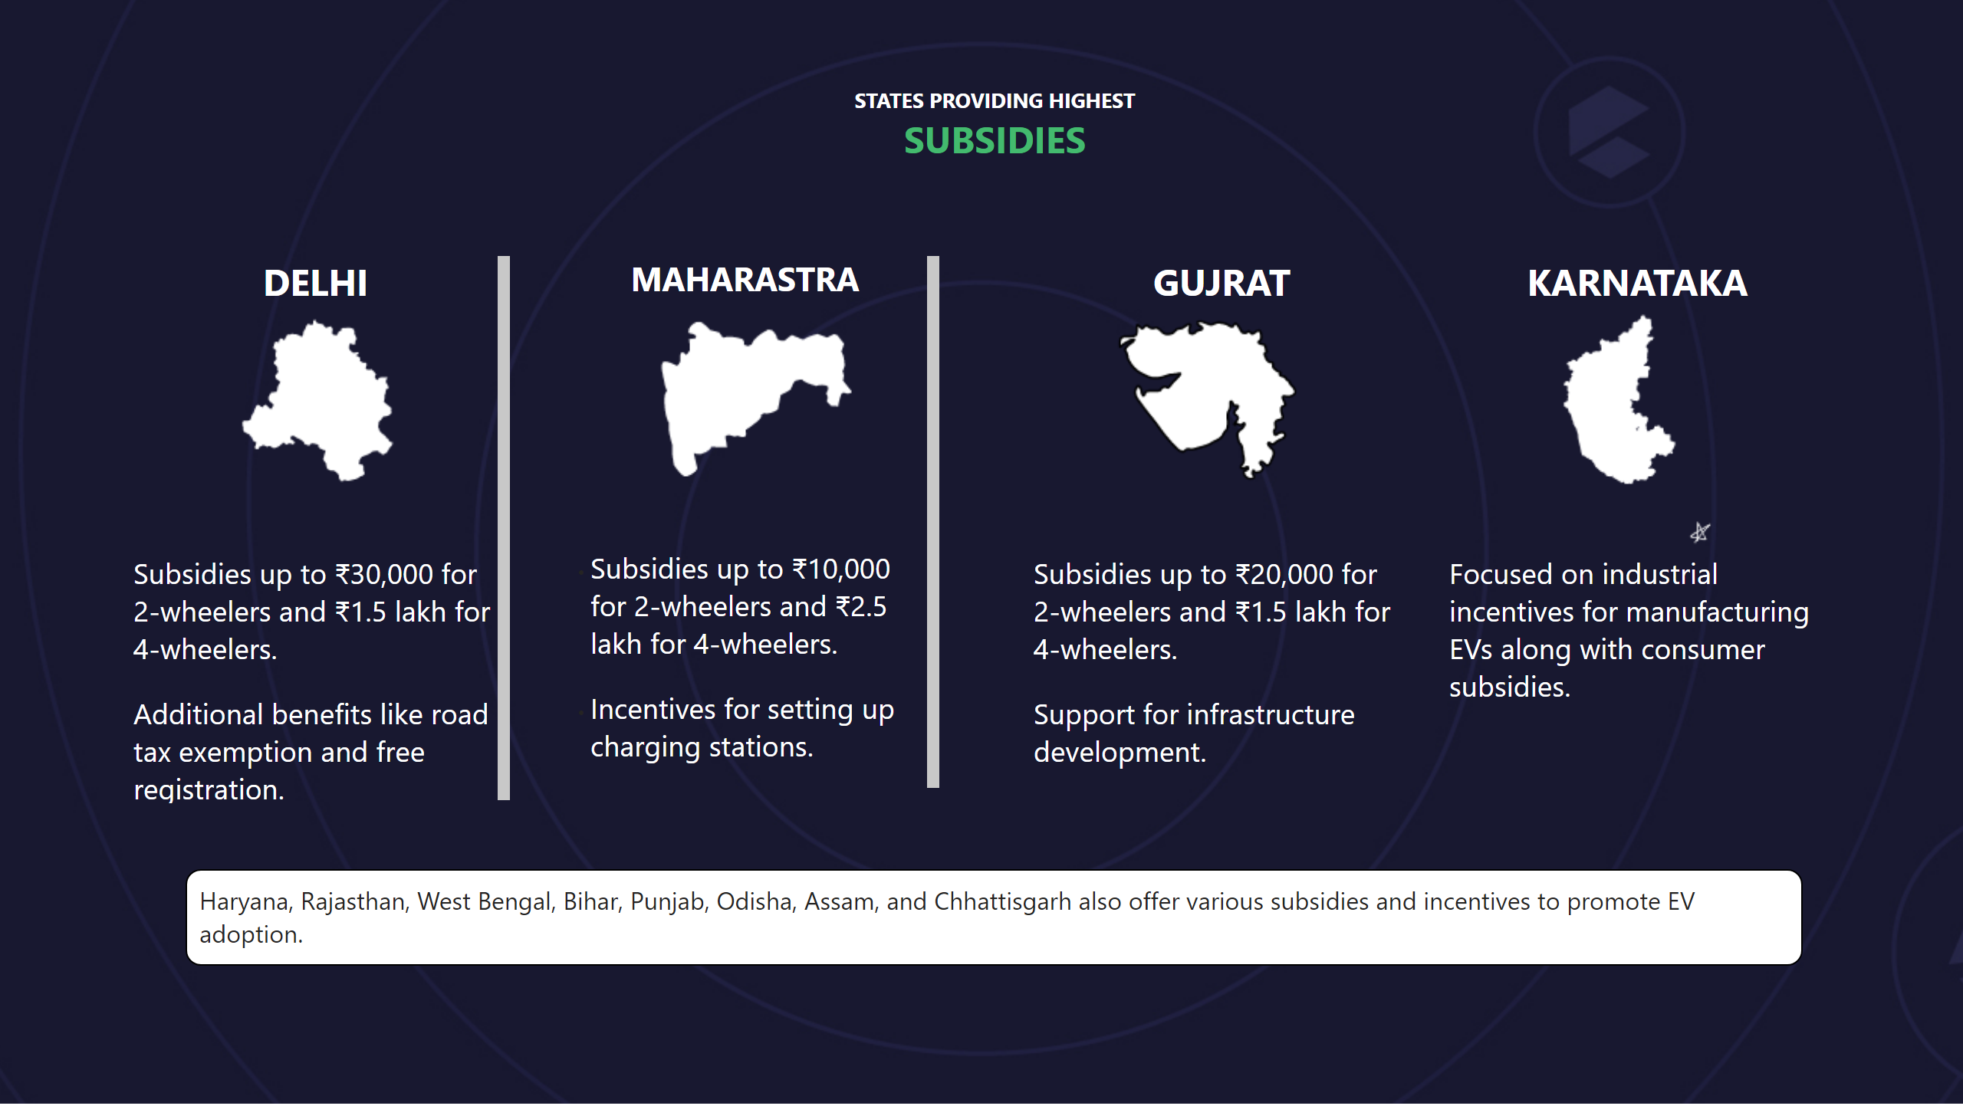
States
Notes:
textbox
No alt text provided
image
No alt text provided
textbox
No alt text provided
textbox
No alt text provided
textbox
No alt text provided
textbox
No alt text provided
textbox
No alt text provided

Slide 18
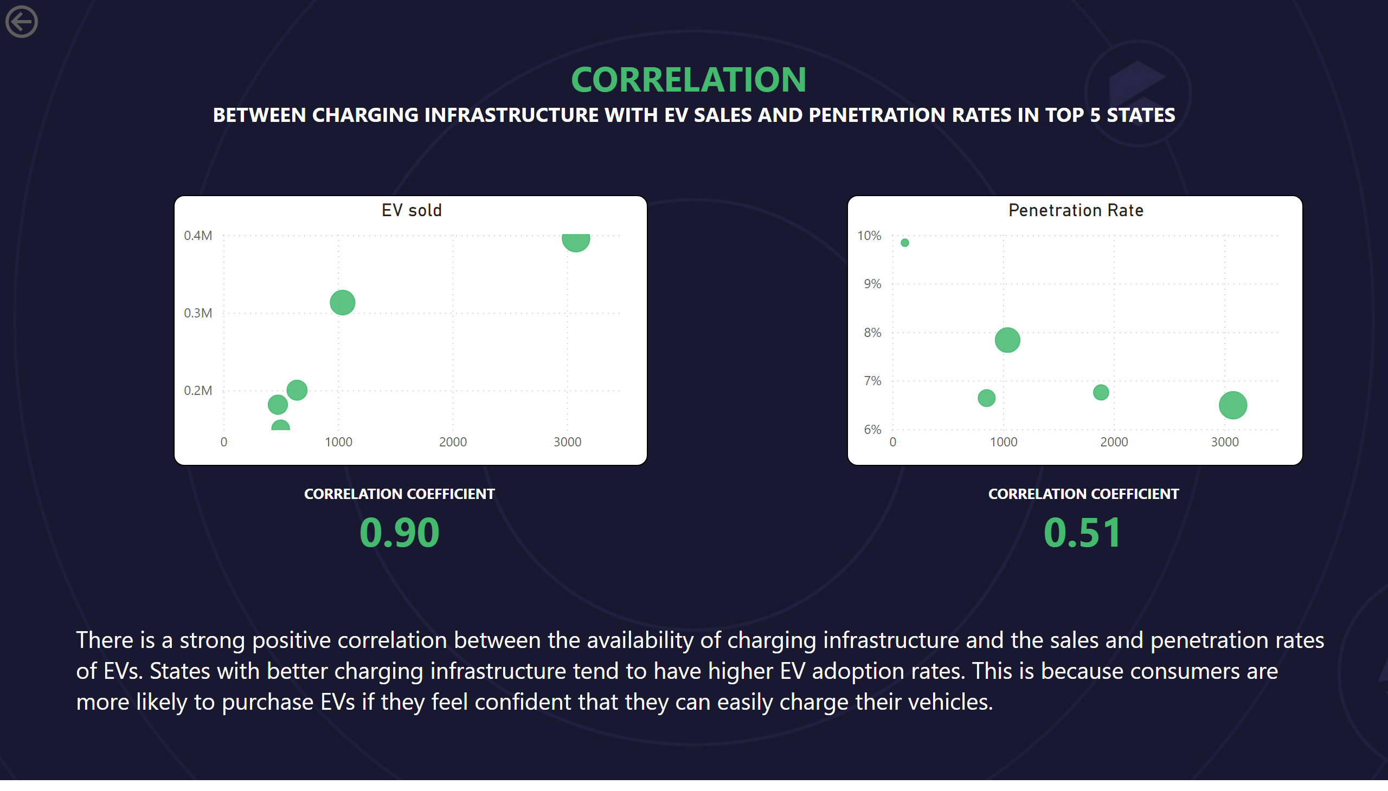
Correlation
Notes:
textbox
No alt text provided
actionButton
No alt text provided
textbox
No alt text provided
EV sold
No alt text provided
Penetration Rate
No alt text provided
textbox
No alt text provided
textbox
No alt text provided

Slide 19
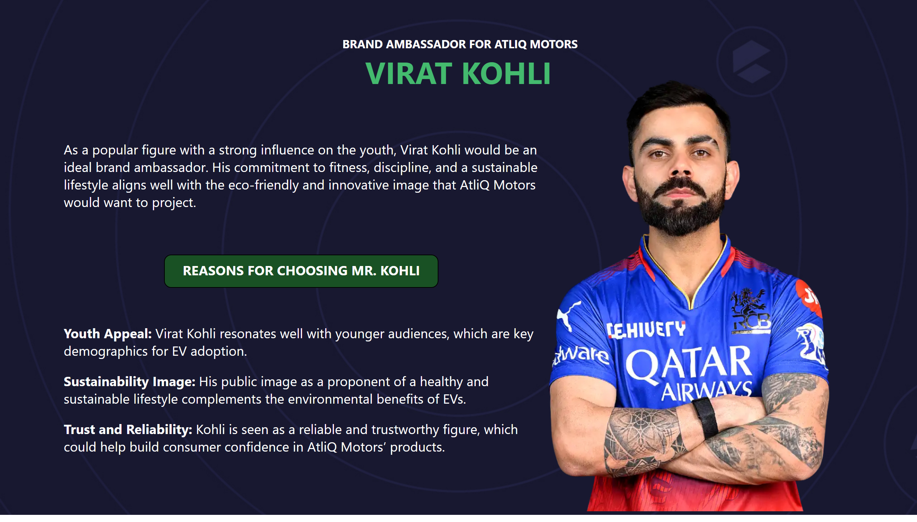
Brand Ambassador
Notes:
textbox
No alt text provided
textbox
No alt text provided
textbox
No alt text provided
image
No alt text provided
textbox
No alt text provided

Slide 20
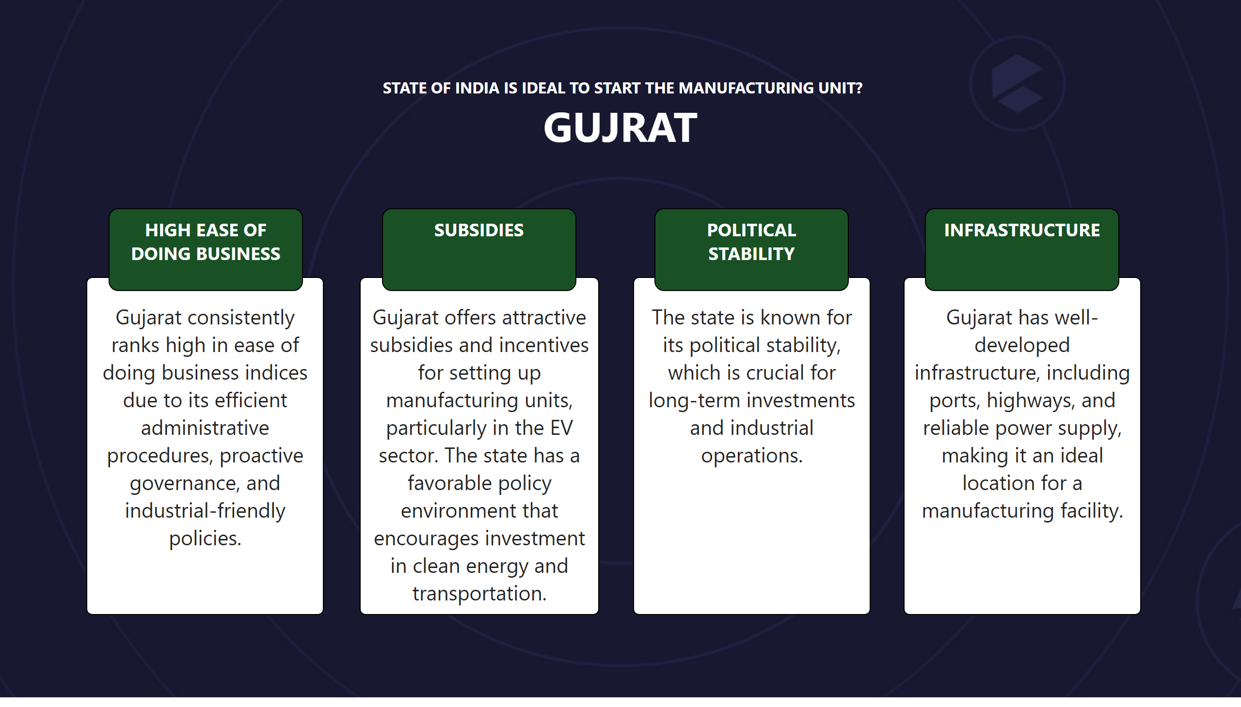
RecState
Notes:
textbox
No alt text provided
textbox
No alt text provided
textbox
No alt text provided
textbox
No alt text provided
textbox
No alt text provided
textbox
No alt text provided
textbox
No alt text provided
textbox
No alt text provided
textbox
No alt text provided

Slide 21
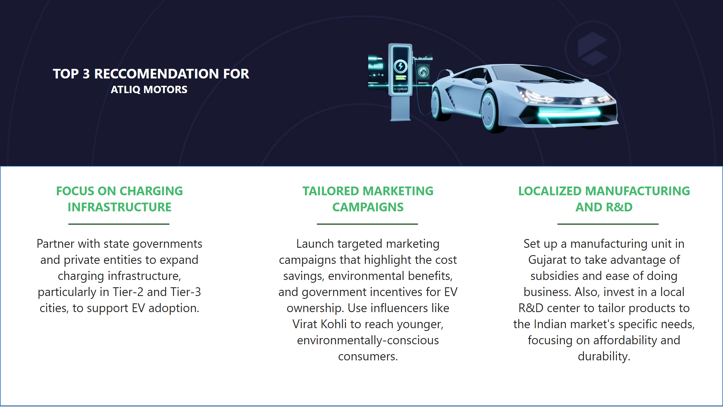
Reccomendation
Notes:
textbox
No alt text provided
textbox
No alt text provided
textbox
No alt text provided
textbox
No alt text provided
shape
No alt text provided
shape
No alt text provided
shape
No alt text provided
shape
No alt text provided
image
No alt text provided

